Slide 1
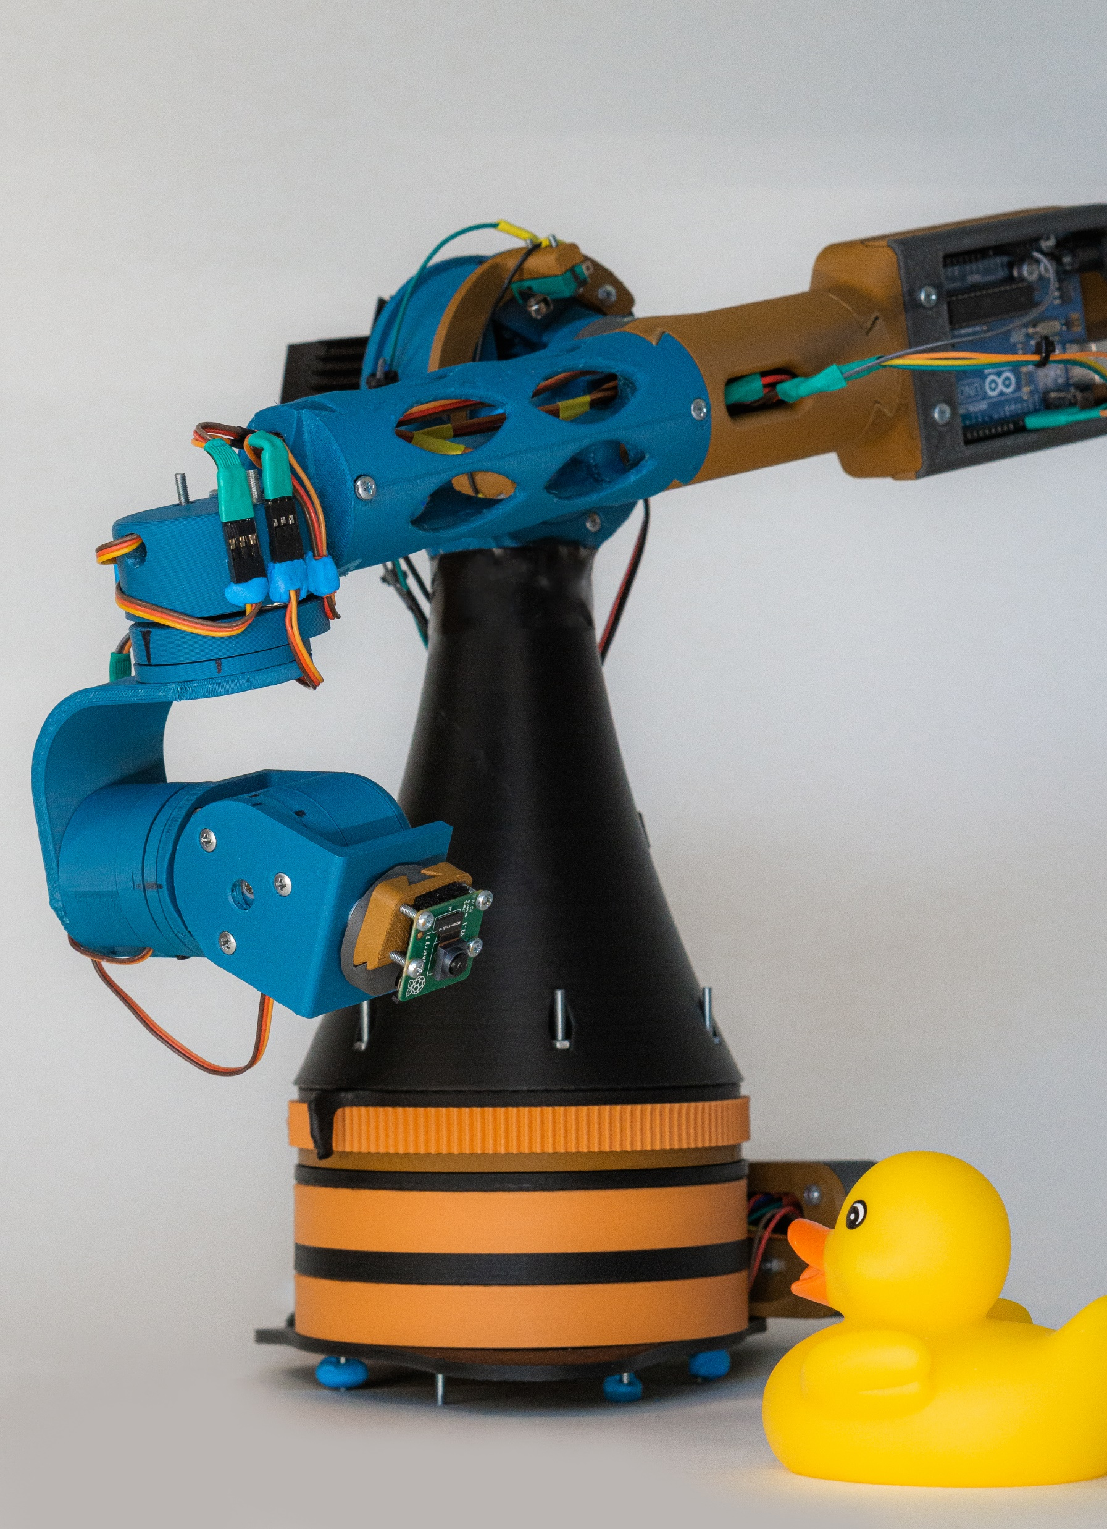
Cinebot Alpha
Course project of
Nikola Totev
for
Practical robotics & Smart Things
Sofia University
July 2020

Slide 2
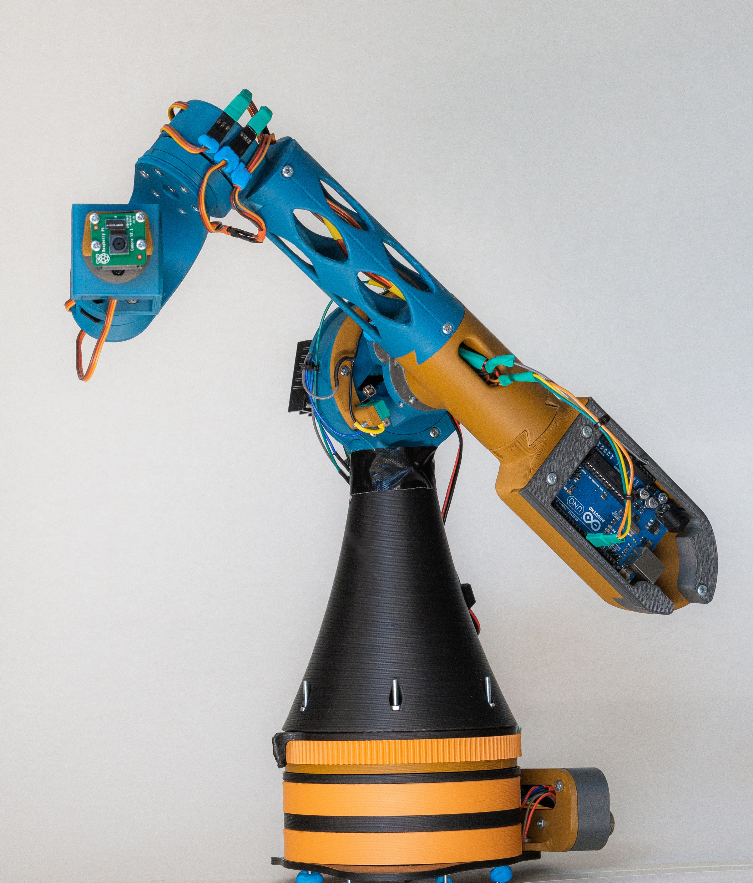
Project overview
Design Concepts
Design challenges
Key features
Used technologies
Development possibilities
Demo

Slide 3
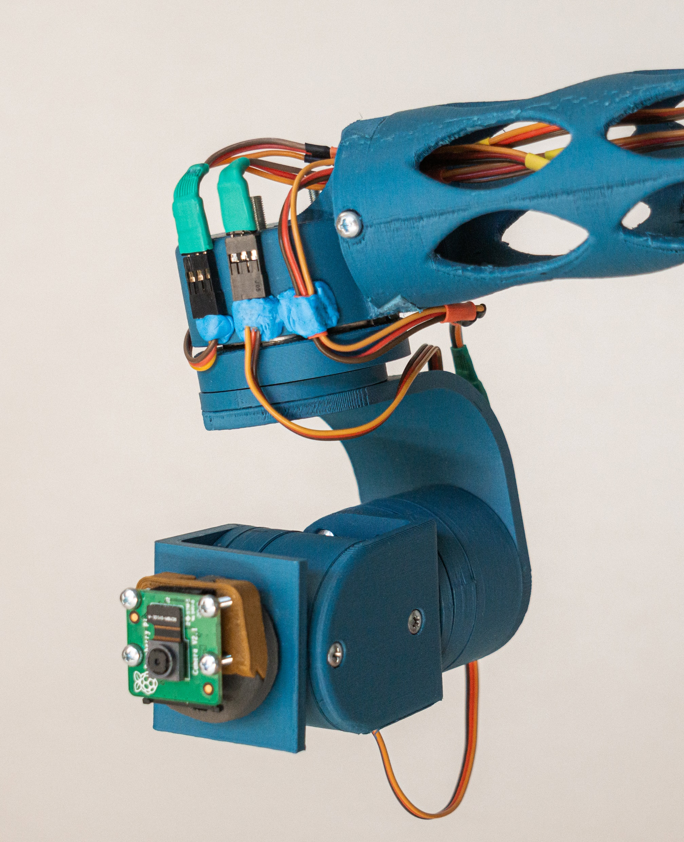
Project overview
What is it?
How is it made?
What can it do?
What can it be used for?

Slide 4
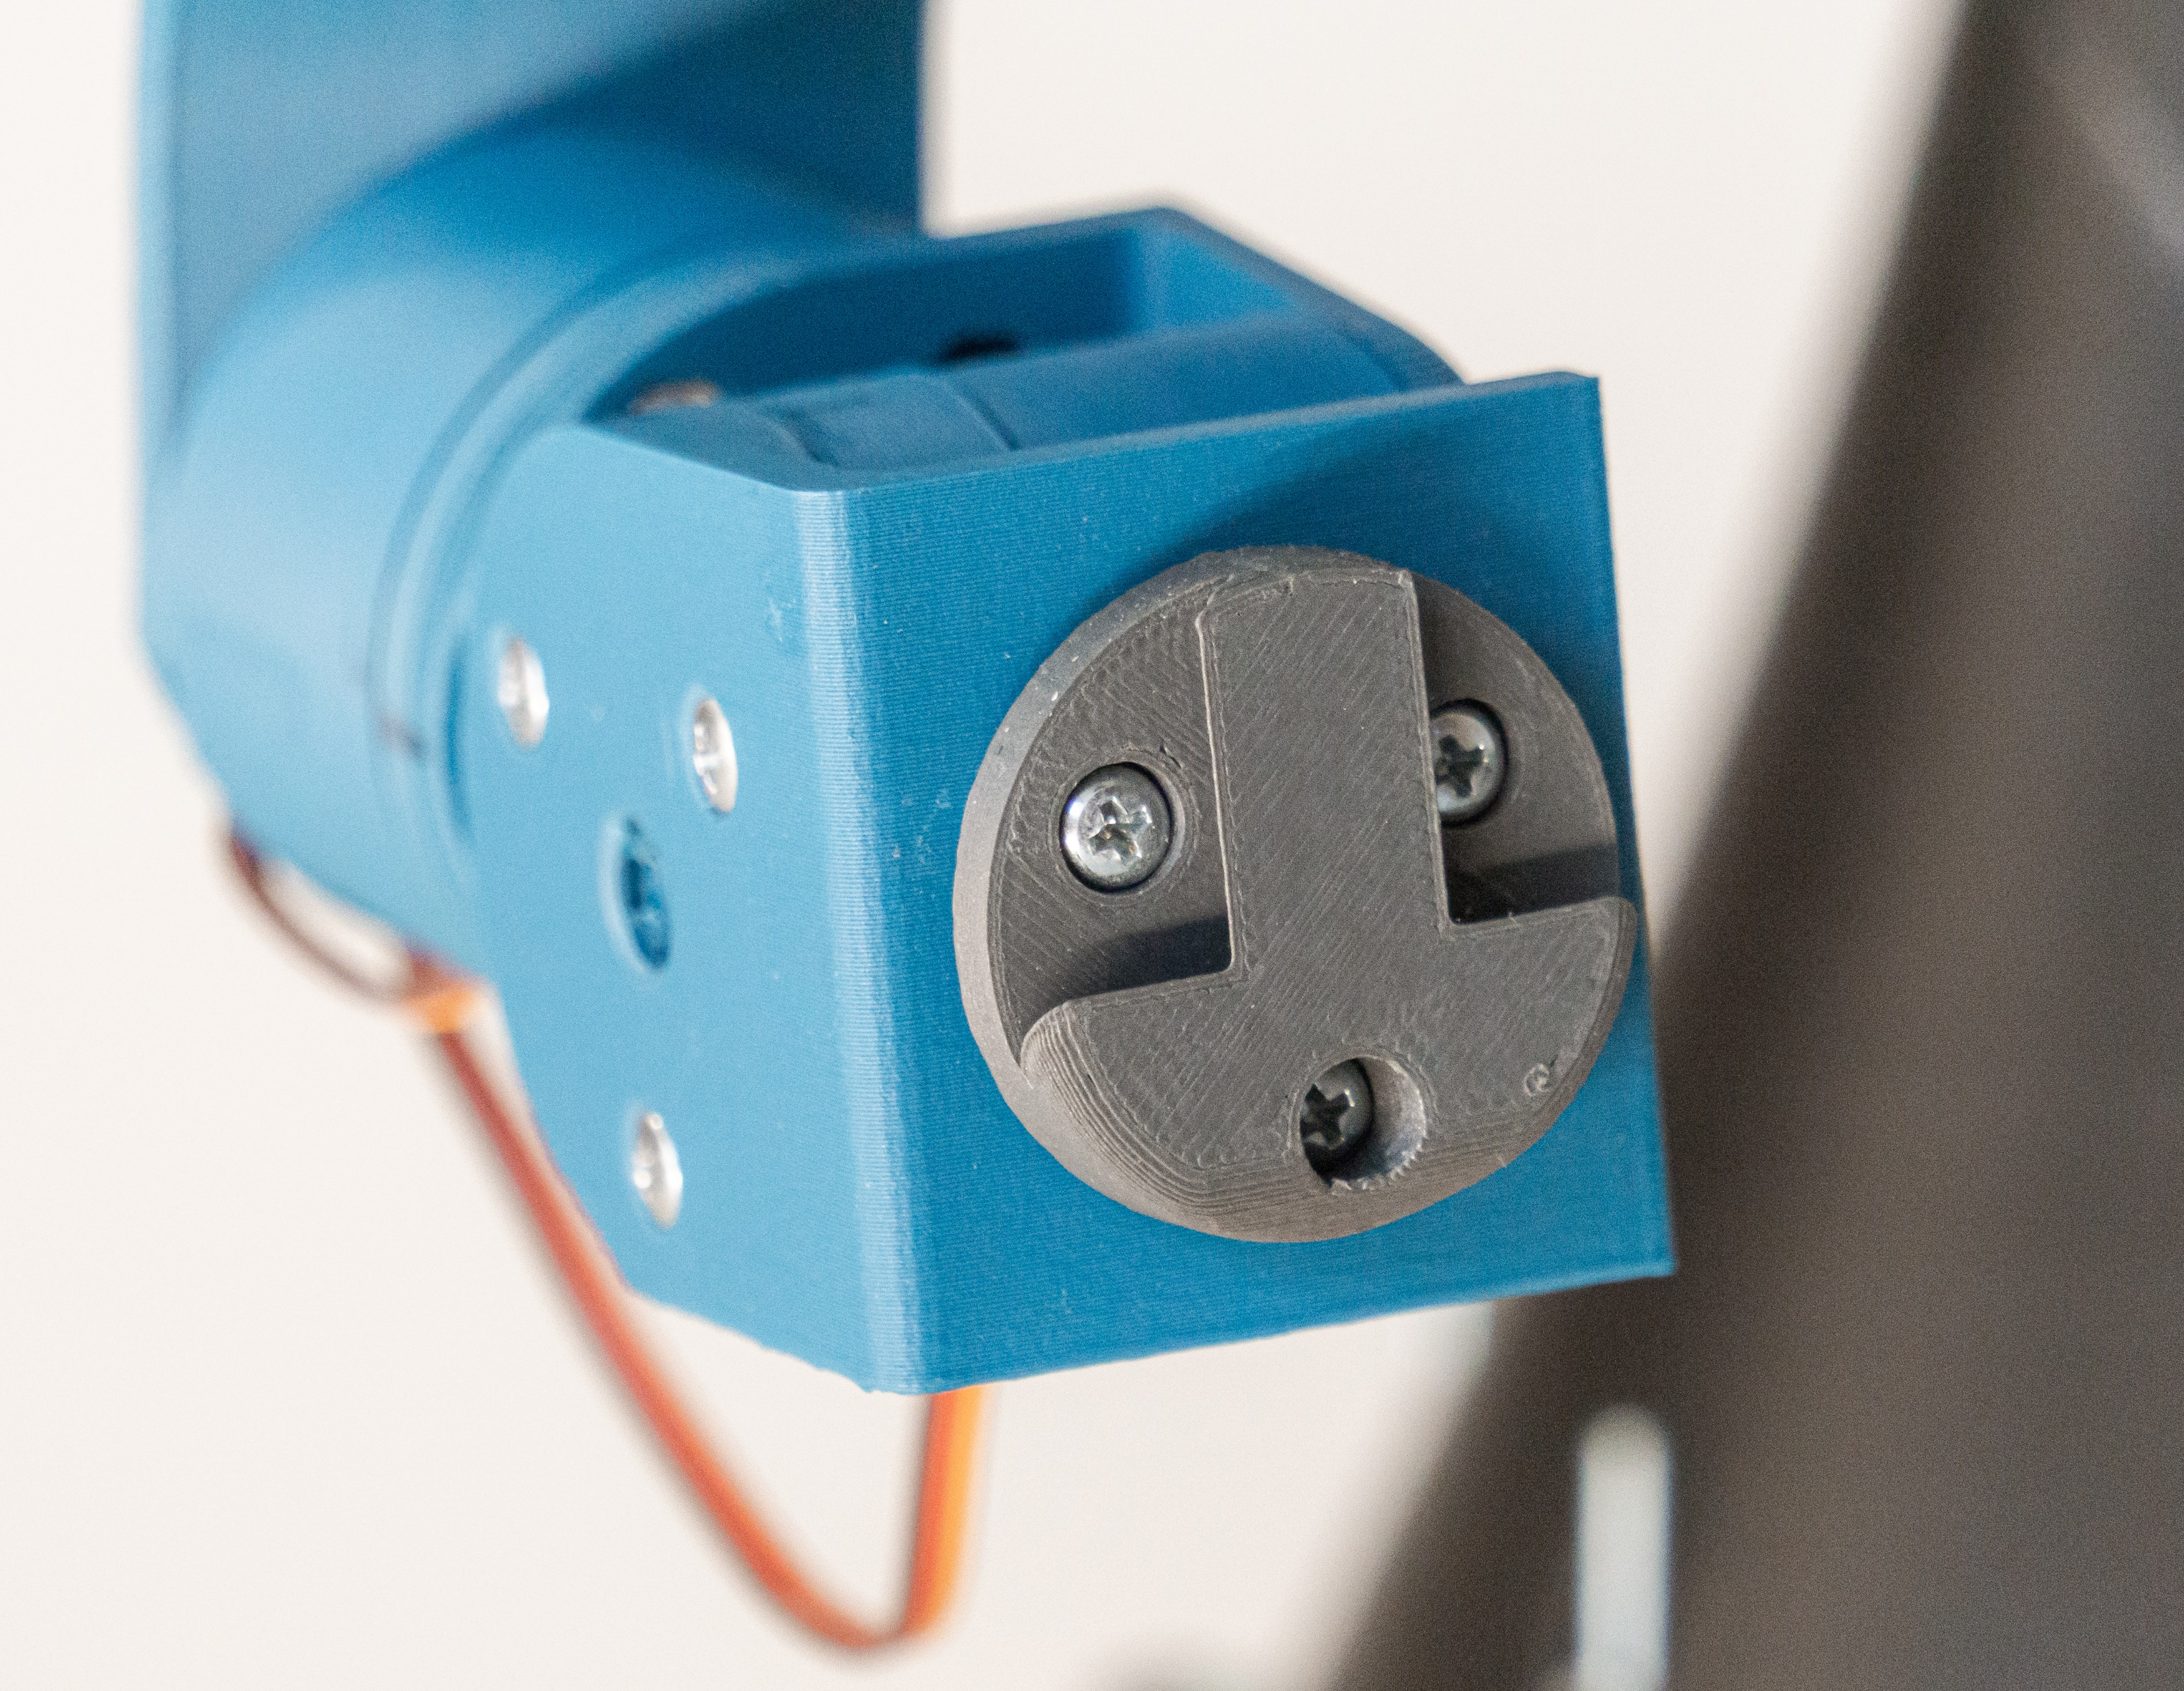
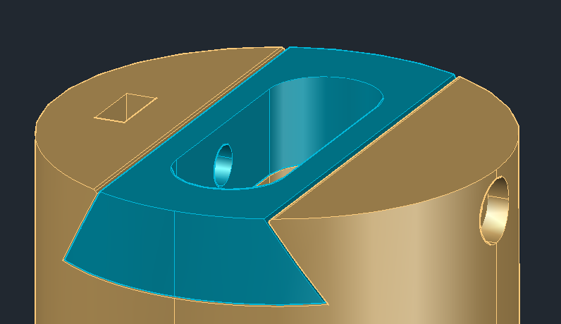
Design Concepts (hardware)
Modularity
Simplicity
3D Printable

Slide 5
Design Concepts (software)
Safety
Modularity
High fault tolerance

Slide 6
Design Challenges (hardware)
No experience with 3D printing or CAD
Unfamiliar with best practices
Lack of knowledge about components

Slide 7
Design Challenges (software)
First time working with Raspberry Pi
No experience programming for Linux
Programming a physical machine
Interprocess communication with UDS
Communication between Rpi & Arduino via Serial

Slide 8
Key Features
Stepper manual move mode (multithreaded)
Gimbal manual move mode
Stepper record mode
Gimbal record mode
Replay mode
Facial tracking (pan only)

Slide 9
Quintic Polynomial Trajectory
What is it?
Why do we need it?
Implementation

Slide 10
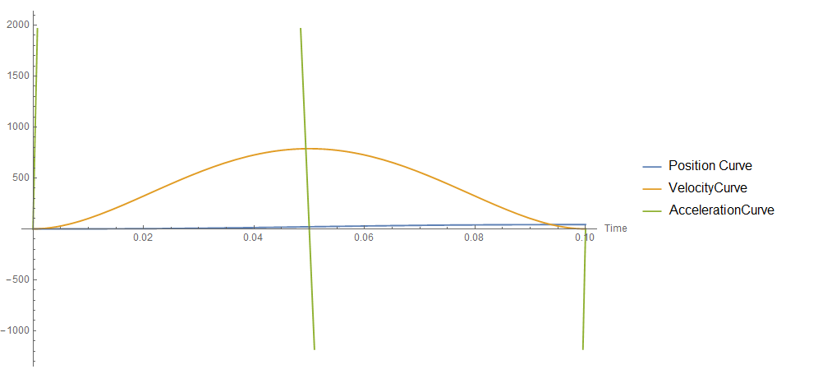

Slide 11
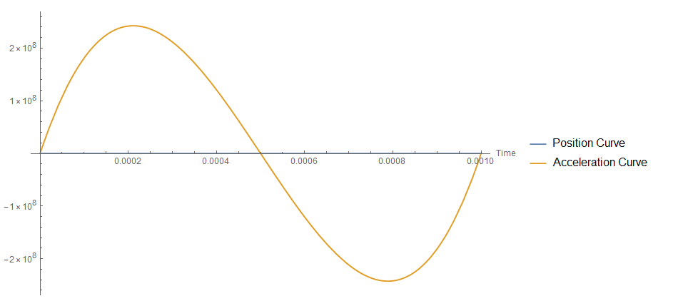

Slide 12
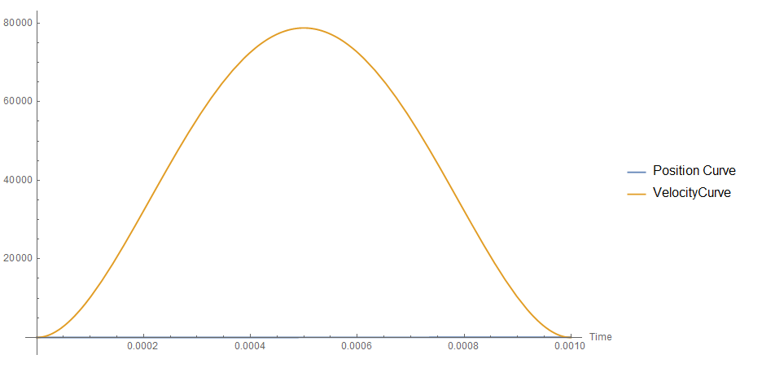

Slide 13
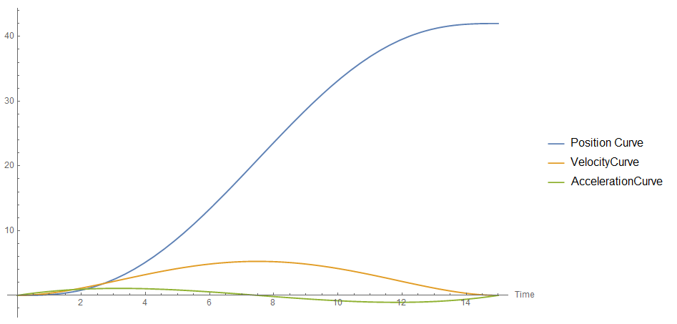

Slide 14
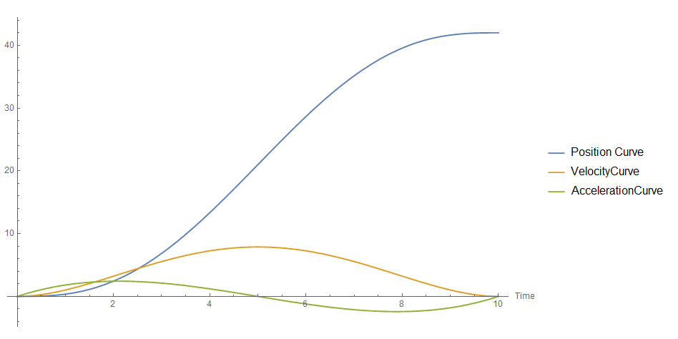

Slide 15
Used technologies (hardware)
3D Printer
Flashforge Creator Pro
Raspberry Pi 4 (2GB)
Rpi Camera V2
Arduino Uno

Slide 16
Used technologies (software)
Languages & libraries:
C# - .NET Core, dotnet iot
C
Python
OpenCV
Operating system – Raspbian
Interprocess communication
Unix Domain Sockets

Slide 17
Development possibilities

Slide 18
Time for a demo

